Slide 1
Data Structures, Algorithms and Design

Slide 2
Contact Session I

Slide 3
Plan of Lecture
Introduction to the Course
Introduction to the Algorithms
Introduction to the Basic Data Structures

Slide 4
Course Introduction
COURSE DESCRIPTION:
The course covers design, implementation and applications of data structures including trees and graphs. The course covers algorithm design techniques using examples from sorting, searching, graph theory, networking and number theory.
The scope of the designs will include complexity issues and suitability issues.

Slide 5
Course Objectives
CO1 | Introduce mathematical and experimental techniques to analyze algorithms
CO2 | Introduce linear and non-linear data structures and best practices to choose appropriate data structure for a given application
CO3 | Teach various dictionary data structures (Lists, Trees, Heaps) with illustrations on possible representation, various operations and their efficiency
CO4 | Exposes students to various sorting and searching techniques
CO5 | Discuss in detail various algorithm design approaches (Greedy method, divide and conquer, dynamic programming, backtracking, and branch and bound) with appropriate examples, methods to make correct design choice and the efficiency concerns.
CO6 | Introduce complexity classes , notion of NP-Completeness, ways of classifying problem into appropriate complexity class
CO7 | Introduce reduction method to prove a problem’s complexity class.

Slide 6
TEXT BOOK (T):
Algorithms Design: Foundations, Analysis and Internet Examples, by Michael T. Goodrich, Roberto Tamassia, 2006, Wiley (Students Edition)
REFERENCE BOOKS (R):
Data Structures, Algorithms and Applications in C++, Sartaj Sahni, Second Ed, 2005, Universities Press
Cormen T.H., Leiserson, C.E., Rivest, R.L., and C. Stein. Introduction to Algorithms, MIT Press, Second Edition (Indian reprint: Prentice-Hall).

Slide 7
Learning Outcomes
LO1 | Describe various fundamental data structures, their properties, algorithm design techniques and various means of evaluating algorithms
LO2 | Demonstrate the ability to evaluate algorithms, to select from a range of possible options, to provide justification for that selection, and to implement the algorithm in a particular context.
LO3 | Solve problems using Algorithms for Linear and Non-Linear Data Structures, Graph algorithms (Shortest Paths Algorithms, Connectivity and Reachability Algorithms, Spanning Trees)
LO4 | Explain with a practical example, each of the algorithm design strategies (brute-force, greedy, divide-and-conquer, recursive backtracking, and dynamic programming)
LO5 | Use brute-force, greedy, divide-and-conquer, recursive backtracking, and dynamic programming techniques to solve a given algorithm design problem.
LO6 | Relate the real-world problems to known data structures and algorithms leading to the recommend appropriate solutions in representation and implementation.
LO7 | Explain the significance of NP-completeness
LO8 | Classify problems into complexity classes P and NP and to prove hardness of problems

Slide 8
EVALUATION SCHEME
Evaluation Component | Name (Quiz, Lab, Project, Midterm exam, End semester exam, etc) | Type (Open book, Closed book, Online, etc.) | Weight | Duration | Day, Date, Session, Time
EC - 1 | Quiz-I/ Assignment-I | Online | 5% | - | September 10-20, 2020
 | Quiz-II | Online | 5% | - | October 20-30, 2020
 | Quiz-III/ Assignment-II | Online | 5% | - | November 10-20, 2020
EC - 2 | Mid-term Exam | Closed book | 35% | 2 hours | Saturday, 10/10/2020 (FN) 10 AM - 12 Noon
EC - 3 | End Semester Exam | Open book | 50% | 3 hours | Saturday, 28/11/2020 (FN) 9 AM – 12 Noon

Slide 10
Data Structures, Algorithms and Design
Module 1

Slide 11
ALGORITHM
A well-defined computational procedure that takes some value, or a set of values, as input and produces some value, or a set of values, as output.
It can also be defined as sequence of computational steps that transform the input into the output.

Slide 12
Algorithms and it’s Specification
All algorithms must satisfy the following criteria:
Input. There are zero or more quantities that are externally supplied.
Output. At least one quantity is produced.
Definiteness. Each instruction is clear and unambiguous.
Finiteness. If we trace out the instructions of an algorithm, then for all cases, the algorithm terminates after a finite number of steps.
Effectiveness. Every instruction must be basic enough to be carried out, in principle, by a person using only pencil and paper. It is not enough that each operation be definite as in (3); it also must be feasible.

Slide 13
Algorithms and it’s Specification
The specification is the process of conversion of solution into an algorithm.
Done in 3 ways:
Natural language
Flowchart
Pseudo Code

Slide 14
EFFICIENCY OF AN ALGORITHM
Complexity of algorithm is a function of size of input of a given problem instance which determines how much running time/memory space is needed by the algorithm in order to run to completion.
Time Complexity: Time complexity of an algorithm is the amount of time it needs in order to run to completion.
Space Complexity: Space Complexity of an algorithm is the amount of space it needs in order to run to completion.
There are two points which we should consider about computer programming:-
An appropriate data structure and
An appropriate algorithm.

Slide 15
EFFICIENCY OF AN ALGORITHM
It can be of various types:
Worst case efficiency: It is the maximum number of steps that an algorithm can take for any collection of data values.
Best case efficiency: It is the minimum number of steps that an algorithm can take any collection of data values.
Average case efficiency: It can be defined as
the efficiency averaged on all possible inputs
must assume a distribution of the input
We normally assume uniform distribution (all keys are equally probable)
If the input has size n, efficiency will be a function of n

Slide 16
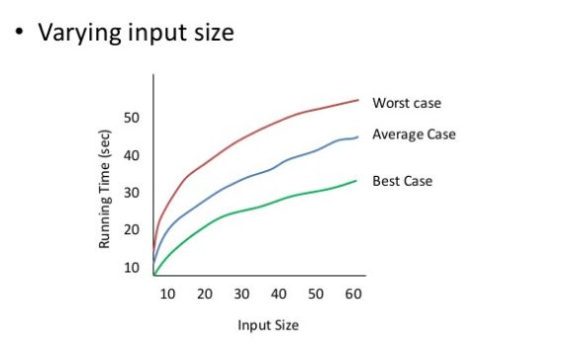
EFFICIENCY OF AN ALGORITHM

Slide 17
Examples
Average in increasing order of the occurrence of number (in ONE loop)
INPUT
OUTPUT
2 | 6 | 4 | 8 | 3 | 8 | 14 | 24 | 54 | 76 | 21 | 87 | 95 | 2 | 45
2 | 8 | 12 | 20 | 23 | 31 | 45 | 69 | 123 | 199 | 220 | 307 | 402 | 404 | 449

Slide 18
Use of Prefix average:
Prefix Averages
Given an array X storing n numbers
We want to compute an array A such that A[i] is the average of elements uptill “i”.
Application
Economics and statistics (year by year update)
“Smoothing" function for a parameter that is quickly changing

Slide 19
Example: Normal Way of solving
Algorithm prefixAveragesl(X):
Input: An n-element array X of numbers.
Output: An n-element array A of numbers such that A [i] is the average of elements X {0],. . . , X [i].
Let A be an array of n numbers.
For i ← 0 to n-1 do
a ← 0
For j ← 0 to i do
a ← a+X[j]
A[i] ← a/(i+1)
return array A

Slide 20
Example: Normal Way of solving
Algorithm prefixAveragesl(X):
Input: An n-element array X of numbers.
Output: An n-element array A of numbers such that A [i] is the average of elements X {0],. . . , X [i].
Let A be an array of n numbers.
For i ← 0 to n-1 do
a ← 0
For j ← 0 to i do
a ← a+X[j] executes 1+2+3+……n times→n(n+1)/2 times
A[i] ← a/(i+1)
return array A So the running time is O(n²)

Slide 21
Example: Better Way of solving
Algorithm prefixAveragesl(X):
Input: An n-element array X of numbers.
Output: An n-element array A of numbers such that A [i] is the average of elements X {0],. . . , X [i].
Let A be an array of n numbers.
For i ← 0 to n-1 do
a ← 0
For j ← 0 to i do
a ← a+X[j]
A[i] ← a/(i+1)
return array A
calculate the sum every time increase complexity
We need to get rid of the loop

Slide 22
Example: Better Way of solving
Algorithm prefixAverages_lI(X):
Input: An n-element array X of numbers.
Output: An n-element array A of numbers such that A [i] is the average of elements X {0],. . . , X [i].
Let A be an array of n numbers.
For i ← 0 to n-1 do
s←s+X[i]
A[i] ←s/(i+1)
return array A

Slide 23
Some More Examples:
To find the Max/Min element for the:
Sorted Array
Unsorted Array
To find the Second Max/Min element for the:
Sorted Array
Unsorted Array
To find the Third Max/Min element for the:
Sorted Array
Unsorted Array
2 | 6 | 4 | 8 | 3 | 8 | 14 | 24 | 54 | 76 | 21 | 87 | 95 | 2 | 45

Slide 24
Some More Examples:
To find the Max/Min element for the:
Want to travers only half a list. (can also be used for top 2)
Using two pointers & traversing with the jump of 1.
Want to travers only one-third of the list. (can also be used for top 3)
Using three pointers & traversing with the jump of 2.
…….
2 | 6 | 4 | 8 | 3 | 8 | 14 | 24 | 54 | 76 | 21 | 87 | 95 | 2 | 45

Slide 25
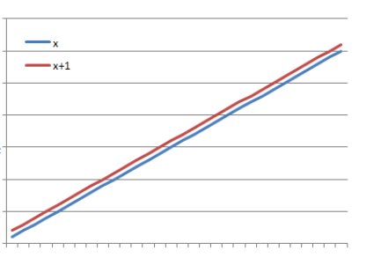
ASYMPTOTIC NOTATIONS
Asymptotic
It means a line that continually approaches a given curve but does not meet it at any finite distance.
Example
(x) is asymptotic with (x + 1) as shown in graph.

Slide 26
ASYMPTOTIC NOTATIONS
Asymptotic may also be defined as a way to describe the behaviour of functions in the limit or without bounds.
Let f(x) and g(x) be two functions of real numbers.
We say that f and g are asymptotic and write f(x) ≈ g(x) if

Slide 27
ASYMPTOTIC NOTATIONS
Big-Oh Notation (O)
It provides possibly asymptotically tight upper bound for f(n) and it does not give best case complexity but can give worst case complexity
We say that f(n) = O(g(n)), iff there are positive constants c and n₀ such that
0 ≤ f(n) ≤ c g(n) for all n ≥ n₀

Slide 28
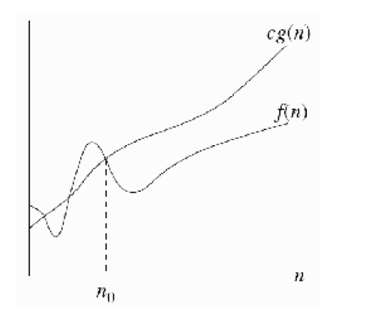
ASYMPTOTIC NOTATIONS
If f(n) = O(g(n)), we say that g(n) is an upper bound on f(n).

Slide 29
ASYMPTOTIC NOTATIONS
Examples –
F (n) = 3n + 2
= 3n+2 as 3n+2 <= 4n for n >=2
= Ο(n)
2) F (n) = 100n +6
= 100n +6 as 100n + 6 <=101n for n>=6
= Ο(n)
3) F (n) = 1000n² + 100n - 6
as 1000n² + 100n - 6 <= 1001n² for n>=100
= Ο(n²)

Slide 30
Corollary:
K*f(n) is O(f(n)) [i.e., constant coefficients can be dropped]
G(n) = 7n⁴ is O(n⁴)
That is, if we have a function multiplied by a constant, we can ignore the constant in the big-O.

Slide 31
Theorem 1 –
Let f₁(x) be O(g₁(x)) and f₂(x) be O(g₂(x)). Then f₁(x)+f₂(x) is O( max(|g₁(x)|,|g₂(x)|) ).
Proof –
There exist k₁,k₂,c₁,c₂, s.t.
|f₁(x)| ≤ c₁|g₁(x)| for all x > k₁, and
|f₂(x)| ≤ c₂|g₂(x)| for all x > k₂
– By the triangle inequality,
|f₁(x)+f₂(x)| ≤ |f₁(x)| + |f₂(x)|
≤ c₁|g₁(x)| + c₂|g₂(x)| for all x > max(k₁, k₂)
≤ c₁ max(|g₁(x)|,|g₂(x)|) + c₂max(|g₁(x)|,|g₂(x)|)
≤ (c₁ + c₂) |max( |g₁(x)|, |g₂(x)| ) |
– Using c = c₁ + c₂, and k = max(k₁, k₂), we have that
f₁(x)+f₂(x) is O( max( |g₁(x)|, |g₂(x)| ) ).

Slide 32
Theorem 2
Let f(x) = a_{n}x^{n} + a_{n-1}x^{n-1} + … + a₁x + a₀, where ∀i (a_{i}∈R). Then f(x) is O(x^{n}).
Proof
For this proof, we will assume the “triangle inequality”
∀x∀y ( |x+y| ≤ |x| + |y| ).
Using this property,
|f(x)| ≤ | a_{n}x^{n} | + | a_{n-1}x^{n-1} | + … + |a₁x| + |a₀|
= x^{n}(|a^{n}| + |a_{n-1}|/x + … + |a₁|/x^{n-1} + |a₀|/x^{n})
≤ x^{n}(|a_{n}| + |a_{n-1}| + … + |a₁| + |a₀|) for x > 1
– So using c = |a_{n}| + |a_{n-1}| + … + |a₁| + |a₀| and k = 1 gives
∀x ( (x > k) → ( |f(x)| ≤ c|g(x)| ) ),
completing the proof.

Slide 33
ASYMPTOTIC NOTATIONS
Big-Omega Notation (Ω)
It provides possibly asymptotically tight lower bound for f(n) and it does not give worst case complexity but can give best case complexity
f(n) = Ω(g(n)), iff there are positive constants c and n₀ such that
0 ≤ c g(n) ≤ f(n) for all n ≥ n₀

Slide 34
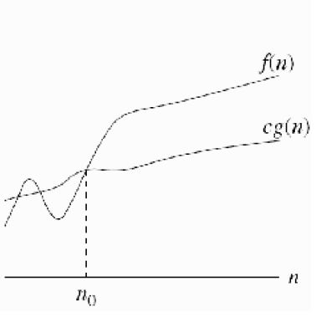
ASYMPTOTIC NOTATIONS
If f(n) = Ω(g(n)), we say that g(n) is a lower bound on f(n).

Slide 35
ASYMPTOTIC NOTATIONS
Examples –
F (n) = 3n+2
= 3n+2 as 3n+2 >= 3n for n >=1
= Ω (n)
2) F (n) = 100n + 6
= 100n + 6 as 100n + 6 >=100n for n>=1
= Ω (n)
3) F (n) = 1000n² + 100n - 6
as 1000n² + 100n -6 >= 1000n² for n>=1
= Ω (n²)

Slide 36
f(n) is not Og(n)
f(n)=n² & g(n)=n;
f(n) is Ω(g(n)), but f(n) is NOT O(g(n))
f(n)=n³ & g(n)= n² ;
f(n) is Ω(g(n)), but f(n) is NOT O(g(n))
f(n)=n and g(n)=n^{(1 + sin(x))}.
f(n) is not O(g(n)) and g(n) is not O(f(n))

Slide 37
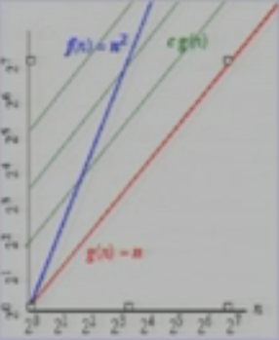
f(n) is not Og(n)
f(n)=n² & g(n)=n
There is no c and n₀ such that n² <= cn for n>= n₀
For every large c is chosen there is an n big enough that n² >cn

Slide 38
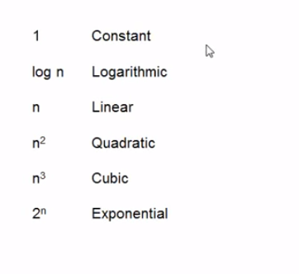
Running Time
Time complexity are generally of the order of below types :-

Slide 39
The Growth Rate of the Six Popular functions
n | logn | n | nlogn | n² | n³ | 2^{n}
4 | 2 | 4 | 8 | 16 | 64 | 16
8 | 3 | 8 | 24 | 64 | 512 | 256
16 | 4 | 16 | 64 | 256 | 4,096 | 65,536
32 | 5 | 32 | 160 | 1,024 | 32,768 | 4,294,967,296
64 | 6 | 64 | 384 | 4,094 | 262,144 | 1.84 * 10¹⁹
128 | 7 | 128 | 896 | 16,384 | 2,097,152 | 3.40 * 10³⁸
256 | 8 | 256 | 2,048 | 65,536 | 16,777,216 | 1.15 * 10⁷⁷
512 | 9 | 512 | 4,608 | 262,144 | 134,217,728 | 1.34 * 10¹⁵⁴
1024 | 10 | 1,024 | 10,240 | 1,048,576 | 1,073,741,824 | 1.79 * 10³⁰⁸

Slide 40
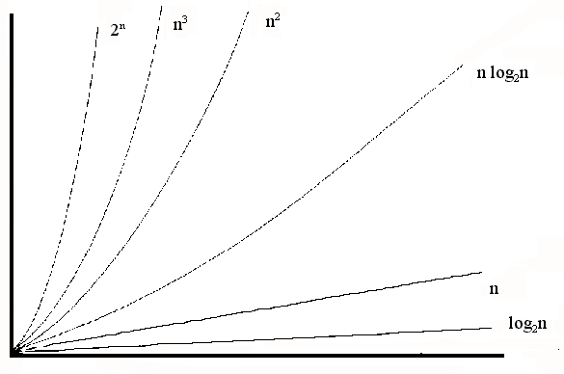
Common growth rates

Slide 41
Another Method to calculate Complexity

Slide 42
Random Access Machine model
Algorithms can be measured in a machine-independent way using the Random Access Machine (RAM) model.
This model assumes a single processor.
In the RAM model, instructions are executed one after the other, with no concurrent operations.
This model of computation is an abstraction that allows us to compare algorithms on the basis of performance.

Slide 43
Random Access Machine model
The assumptions made in the RAM model to accomplish this are:
Each simple operation takes 1 time step.
Loops and subroutines are not simple operations.
Each memory access takes one time step, and there is no shortage of memory.
For any given problem the running time of an algorithms is assumed to be the number of time steps. The space used by an algorithm is assumed to be the number of RAM memory cells.

Slide 44
Random Access Machine model
A set of high-level primitive operations that are largely independent from the programming language used and can be identified also in the pseudo-code.
Primitive operations include the following: -
Assigning a value to a variable
Calling a method
Performing an arithmetic operation (for example, adding two numbers).
Comparing two numbers
Indexing, into an array
Following an object reference
Returning, from a method.

Slide 45
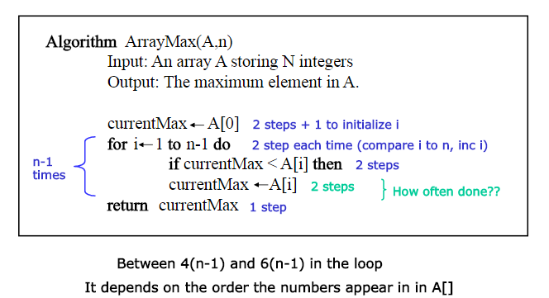
Counting Primitive Operations

Slide 46
Counting Primitive Operations
Total Count(Best and Worst Case) :-
The number of primitive operations t(n) executed by algorithm arrayMax is at least :-
2+1+n+4(n-1)+1=5n
and at most:-
2+1+n+6(n-1)+1=7n-2.
The best case (t(n) = 5n) occurs when A[O] is the maximum element, so that variable currentMax is never reassigned.
The worst case (t(n) = 7n - 2) occurs when the elements are sorted in increasing order, so that variable currentMax is reassigned at each iteration of the for loop.

Slide 47
Counting Primitive Operations
How ?
Before loop:-
Initializing the variable currentMax to A [O] - 2 steps
Initializing of variable i to 1 - 1 step
Comparing two variables i < n - n steps ( loop condition)
Within loop :-
Incrementing i - 2 steps
Comparing currentMax < A[i] - 2 steps
Initializing the variable currentMax to A [i] - 2 steps ( only executed if A[i] > currentMax ); never executed in best case scenario
After loop:-
Return currentMax - 1 step

Slide 48
HomeWork_1
How will you write a simple algorithm to find sum of N natural numbers from 1 to N ?
Write code/algorithm for above and count the number of primitive operations that it does.
Is there any scope of improvement in your algorithm here ?

Slide 49
Problem to solve
Collapse problem (“in ONE loop”)
INPUT
OUTPUT
A |  | B |  |  | C |  | D |  |  | E |  |  |  | F |  |  | G
 |  |  |  |  |  |  |  |  |  |  |  |  | A | B | C | D | E | F | G

Slide 50
Recurrences

Slide 51
Recurrences
Recurrences: The Divide and Conquer approach leads to Recurrence Formulae to represent its time costs:
For Base case (1 is typical, but we could have n larger) T(n) = Θ(1).
For large(r) values of n, T(n) = a T(n/b) + f(n), where f(n) represents the costs of dividing and those of recombining the solutions.

Slide 52
Thank You

